Slide 1


ENGR 1111 Intro to Engineering: Civil Engineering Fall 2022 Part 11: Air Pollution

Slide 2
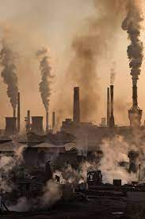
Part 11: Air Pollution
Categorized by:
Personal
Occupational
Indoor
Ambient pollution
An air pollution episode is defined as a major air pollution disaster that results in a large number of people dying

Slide 3
Part 11: Air Pollution
Natural sources:
Particulates from erosion
Emissions from fires, volcanoes, decaying vegetation
Anthropogenic sources:
Motor vehicles
Domestic heating (stoves burning wood, oil, and coal)
Agricultural processes
Power plants
Pulp and paper industry
Metal-processing facilities

Slide 4
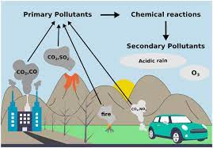
Part 11: Air Pollution
Primary pollutants – emitted directly into the atmosphere from a specific source
Secondary pollutants – produced from chemical reactions between both naturally occurring and anthropogenic gases and particles found in the atmosphere

Slide 5
Part 11: Air Pollution
National Ambient Air Quality Standards (NAAQS)
Criteria Pollutants:
Carbon monoxide (CO)
Nitrogen dioxide (NO₂)
Sulfur dioxide (SO₂)
Lead (Pb)
Particulate matter (PM)
Ozone (O₃)
Primary Standards:
Protect general population
Secondary Standards:
Public Welfare Based

Slide 6
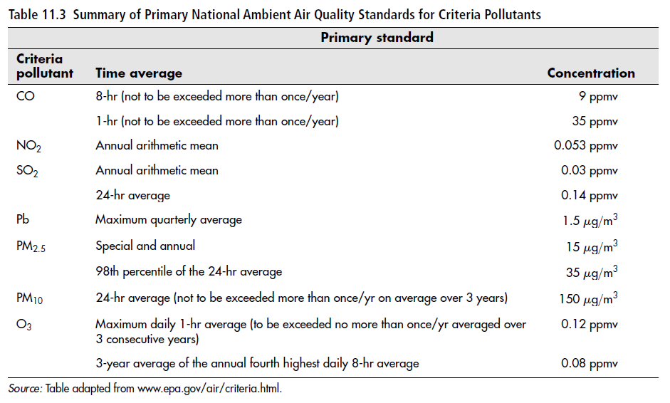
Part 11: Air Pollution

Slide 7
Part 11: Air Pollution
Sources and Effects:
Particulates
Particulate matter (PM) – any dispersed airborne solid or liquid particle that is larger than a single molecule and has an aerodynamic size.
Aerodynamic size – the diameter of a spherical particle with velocity equal to that of the particle but with a density of 1 gram per cubic centimeter
Fumes – particles formed by a chemical reaction or condensation
Mists – large compared to fumes and are formed through condensation
Aerosol – encompasses a large variety of particulates (fumes, mist, smoke, and fog)

Slide 8
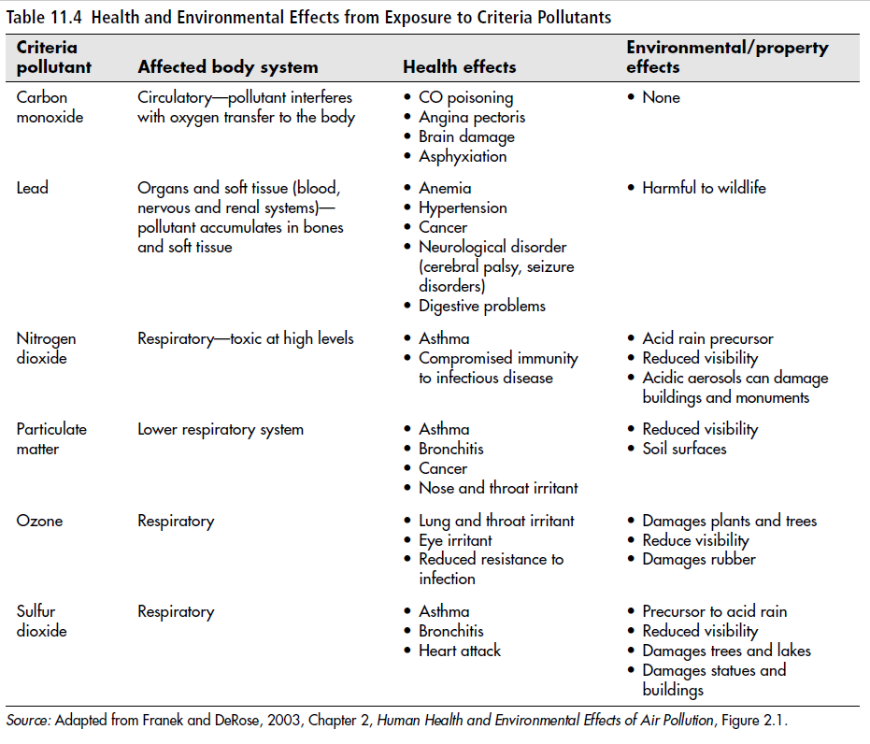
Part 11: Air Pollution

Slide 9
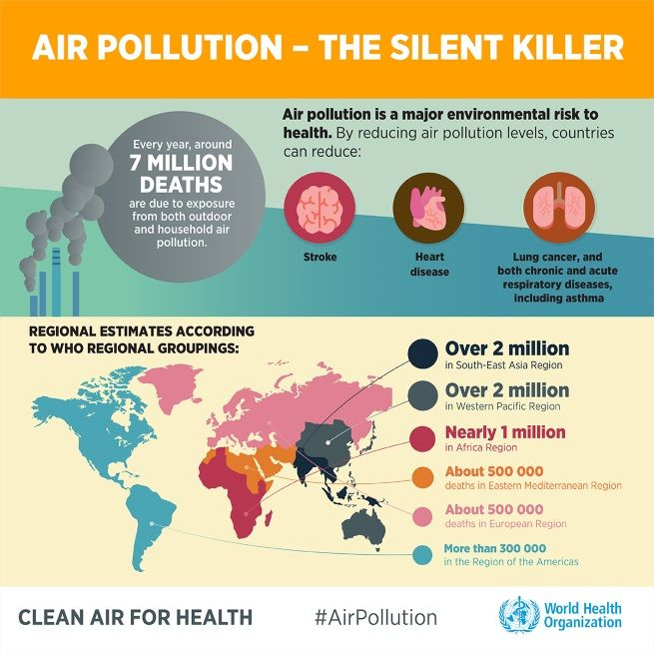
Part 11: Air Pollution
Sources and Effects:
Reduced visibility
Soiling on surfaces
Corrosion
Respiratory issues
Factors
Exposure time
Concentration of Particles
Particle size
Side Effects
Respiratory infections
Heart diseases
Bronchitis
Asthma
Lung Cancer

Slide 10
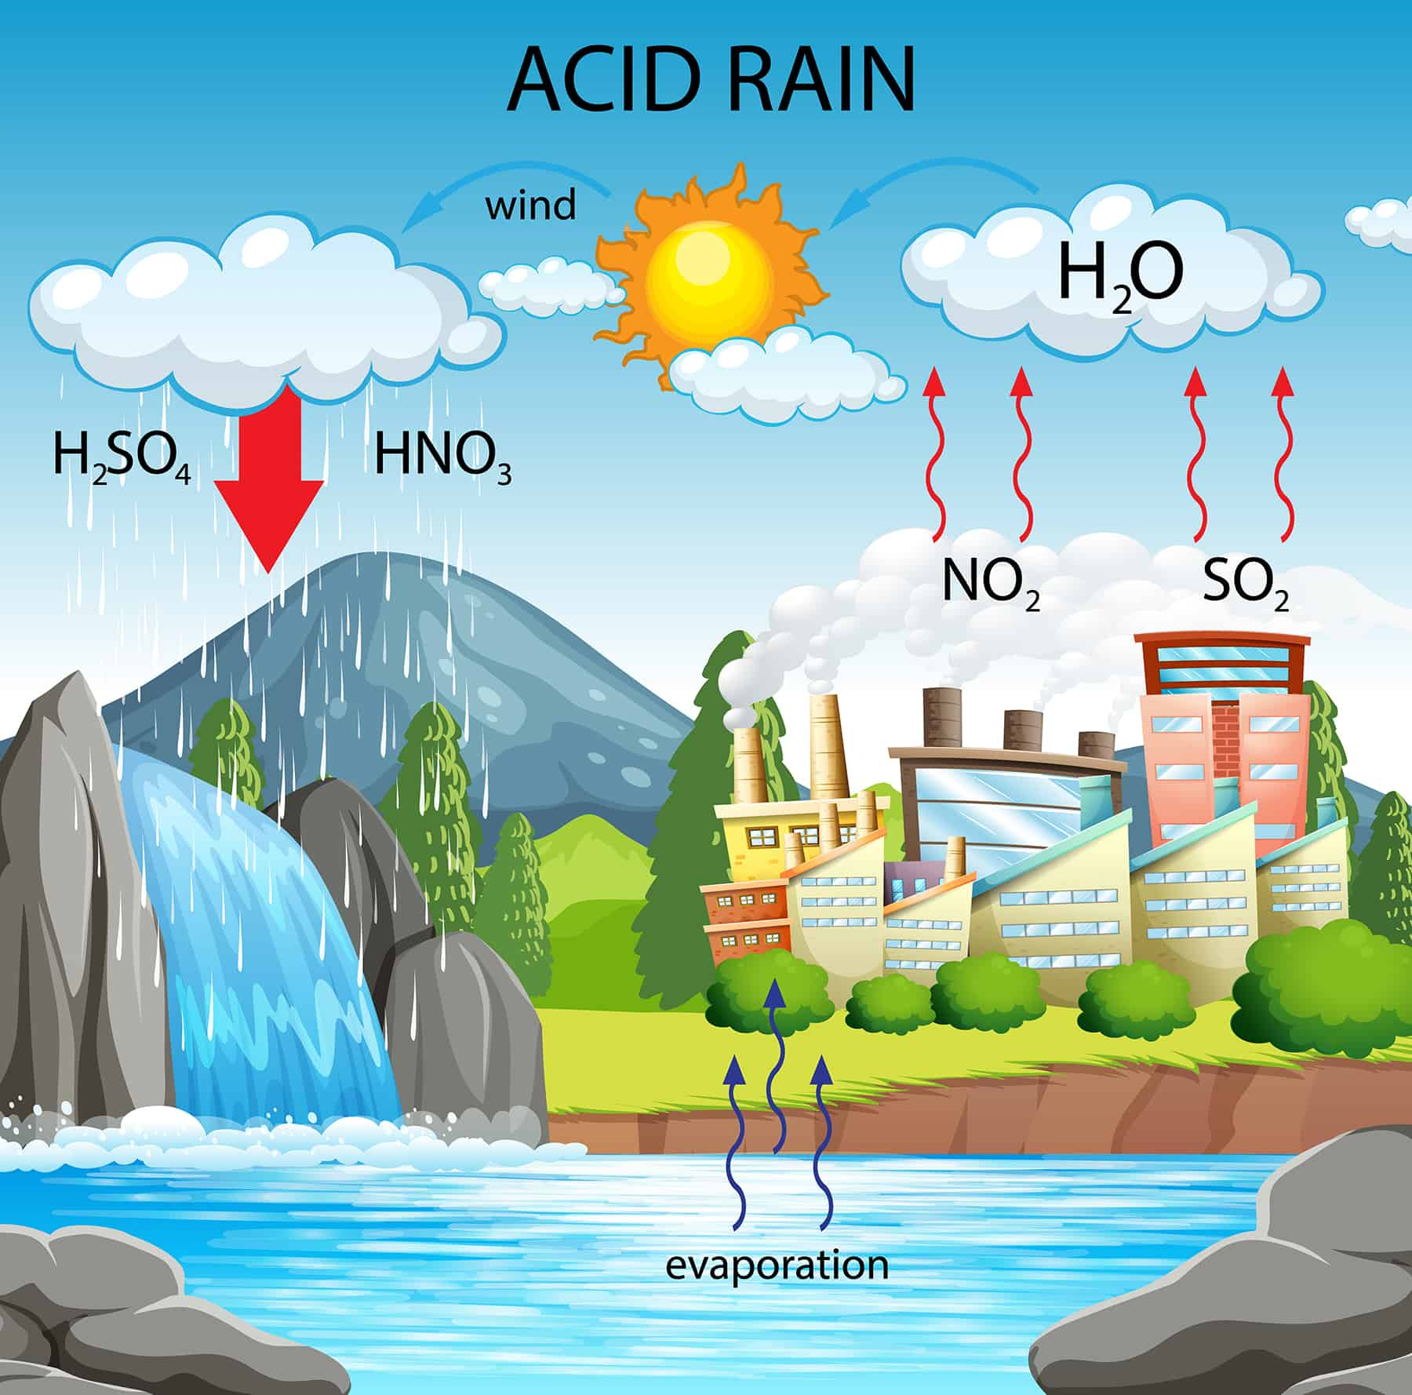
Part 11: Air Pollution
Sources and Effects:
Nitrogen Oxides - formed during any high-temperature combustion process through:
burning of gasoline within automotive internal-combustion engines
combustion of fossil fuels, natural gas, coal, and oil for generating electricity
Nitrogen Oxide compounds are important precursors to ozone and acid rain formation.
Nitrogen Oxide is a reddish-brown, highly reactive gas that has been shown to suppress growth of some crops and affect the lung function of children with preexisting respiratory illness, such as asthma.

Slide 11
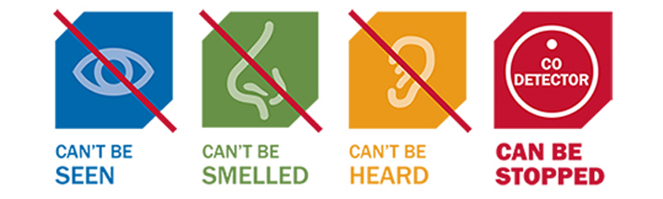
Part 11: Air Pollution
Sources and Effects:
Carbon Monoxide - is a colorless, odorless gas that is commonly emitted as a product of incomplete combustion of gasoline, natural gas, coal, oil, and other hydrocarbons.
There is no known detrimental effect of CO on material surfaces and no harmful effect on higher plant life when the concentration is below 100 ppmv.
When inhaled, CO is absorbed by the lungs and reacts with hemoglobin to form carboxyhemoglobin
At a CO concentration of 100 ppmv, most people experience dizziness and headaches. Concentrations above 750 ppmv will cause death.

Slide 12
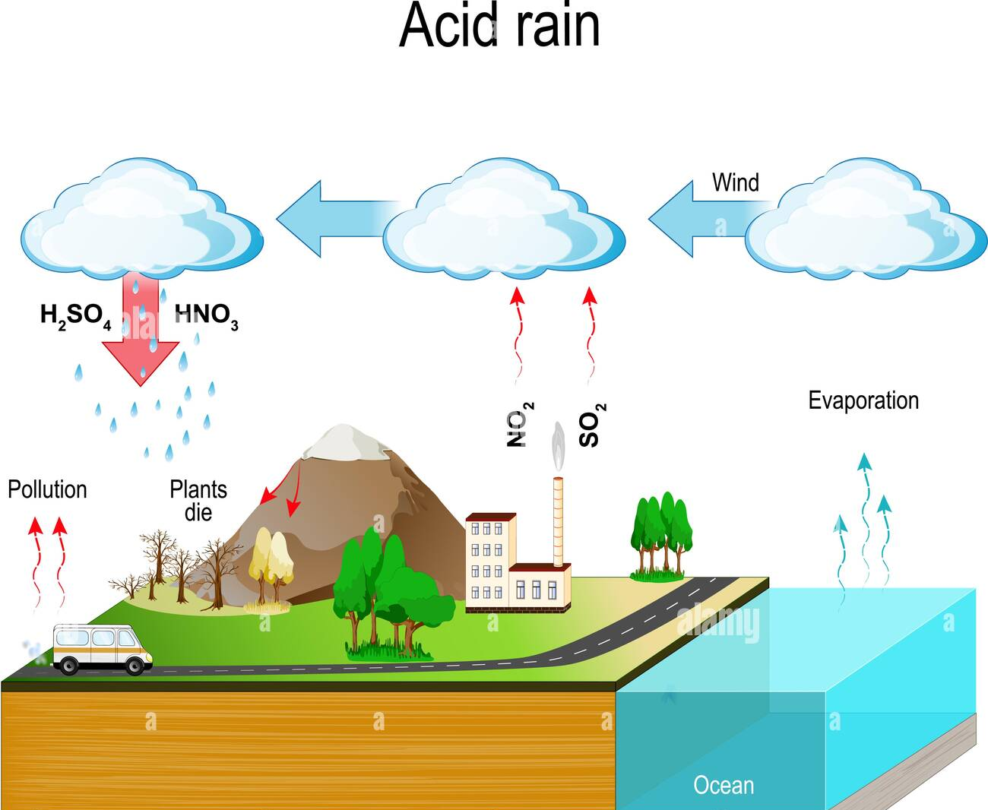
Part 11: Air Pollution
Sources and Effects:
Sulfur oxides - formed during the burning of coal and oil to generate power
Emitted from industrial processes, such as paper and metal production.
Acidic aerosols, such as sulfuric acid are formed when sulfur dioxide reacts with water.
Sulfuric acid aerosols significantly contribute to a decrease in visibility and, along with nitrogen oxides are a major contributor to the acid rain
Metal corrosion is increased in the presence of sulfuric acid.
The inhalation of sulfur dioxide can cause respiratory distress for asthmatic children and adults.

Slide 13
Part 11: Air Pollution
Sources and Effects:
Lead
Historically, the burning of leaded gasoline was the primary source for lead emission into the atmosphere.
As lead was phased out of gas, stationary sources associated with lead, such as storage battery manufacturing, iron and steel production, lead smelting, and the painting of cars and houses are the primary emitters of lead.
Lead compounds tend both to persist and to bioaccumulate in the environment.
In humans, low-level lead poisoning results in kidney and neurological cell damage. Lead may also contribute to hypertension and resulting heart disease. Children are particularly sensitive to the effects of lead exposure, and in animal studies, lead has been shown to reduce fertility and cause birth defects.

Slide 14
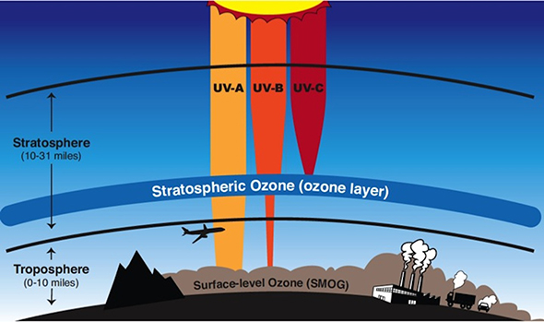
Part 11: Air Pollution
Sources and Effects:
Ozone - photochemical oxidant, is a secondary pollutant formed by a series of reactions
Ozone exposure has been linked to increased hospital visits resulting from respiratory distress. Ozone exposure aggravates preexisting conditions, such as asthma, and has been shown to increase coughing, chest pain, and susceptibility to respiratory infection. Ozone also affects the growth and yield of vegetation and may increase a plant’s susceptibility to disease. Visible injury to leaves may also be apparent. Both natural and synthetic rubber polymers are susceptible to cracking and hardening from contact with ozone.

Slide 15
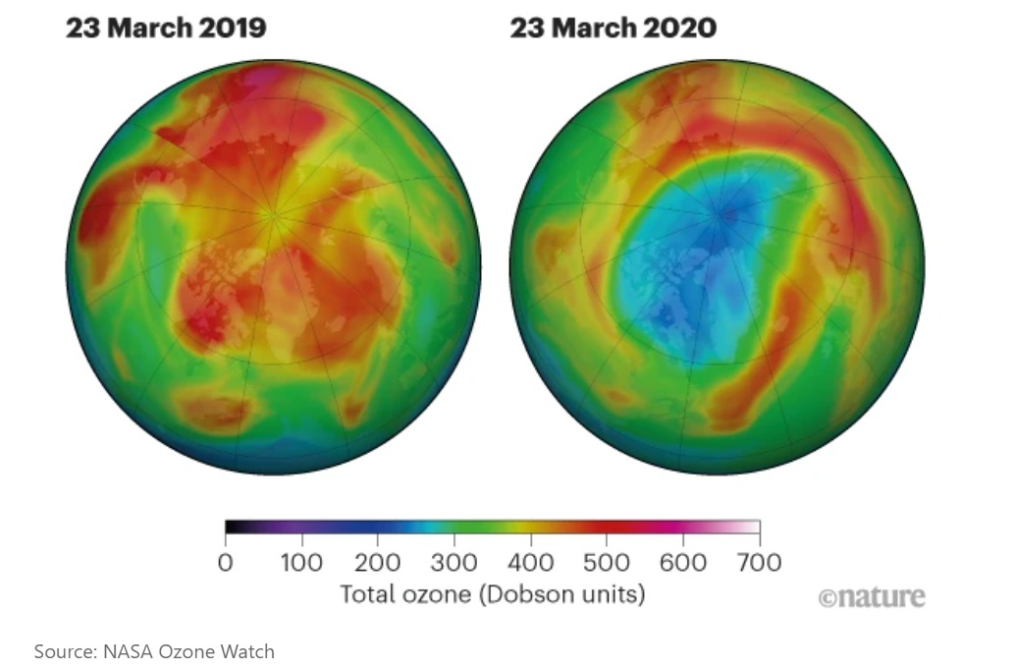
Part 11: Air Pollution

Slide 16
ENGR 1111 Intro to Engineering: Civil Engineering Fall 2022 Part 11: Air Pollution

